Slide 1
Deep Learning from Scratch
Theory + Practical
FAHAD HUSSAIN
MCS, MSCS, DAE(CIT)
Computer Science Instructor of well known international Center
Also, Machine Learning and Deep learning Practitioner
For further assistance, code and slide https://fahadhussaincs.blogspot.com/
YouTube Channel : https://www.youtube.com/fahadhussaintutorial

Slide 2
Different types of Neural Network
Perceptron (Multilayer Perceptron) & ANN
Feedforward Neural Network – Artificial Neuron
Radial Basis Function Neural Network
Convolutional Neural Network
Recurrent Neural Network(RNN) –
Long Short Term Memory
For further assistance, code and slide https://fahadhussaincs.blogspot.com/
YouTube Channel : https://www.youtube.com/fahadhussaintutorial

Slide 3
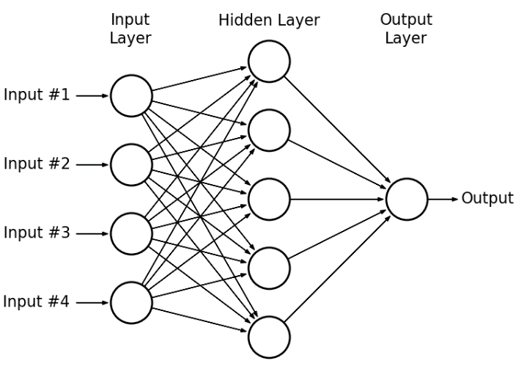
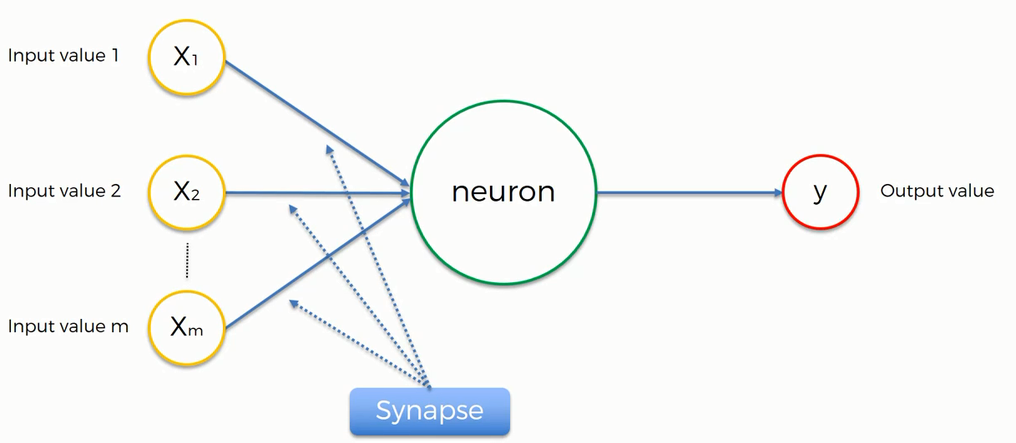
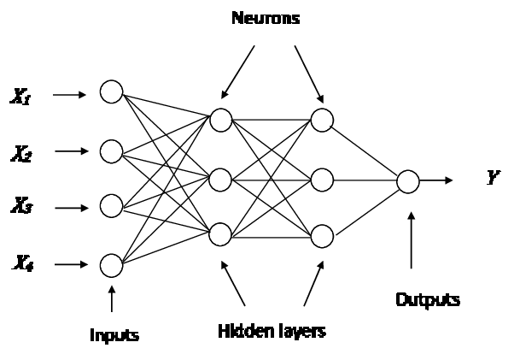
Perceptron (Multilayer Perceptron) & ANN
A perceptron is a network with two layers, one input and one output. ... Artificial neural network, which has input layer, output layer, and two or more trainable weight layers (constisting of Perceptrons) is called multilayer perceptron or MLP
For further assistance, code and slide https://fahadhussaincs.blogspot.com/
YouTube Channel : https://www.youtube.com/fahadhussaintutorial

Slide 4
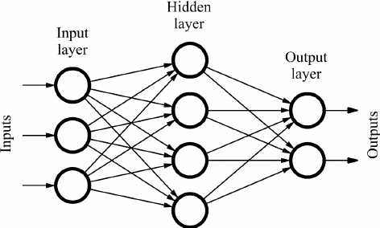
Feedforward Neural Network
It is one of the simplest types of artificial neural networks. In a feedforward neural network, the data passes through different input nodes until it reaches the output node. In other words, the data moves in only one direction from the first range until it reaches the output node. It is also known as a front propagating wave which is usually obtained using a graded activation function. Unlike more complex types of neural networks, backpropagation and data move in only one direction. A feedforward neural network may consist of a single layer or may contain hidden layers. In a feedful neural network, the products of the inputs and their weights are calculated. This is then fed to the output.
whereas
Backpropagation is a training algorithm consisting of 2 steps:
Feedforward the values.
Calculate the error and propagate it back to the earlier layers.
For further assistance, code and slide https://fahadhussaincs.blogspot.com/
YouTube Channel : https://www.youtube.com/fahadhussaintutorial

Slide 5
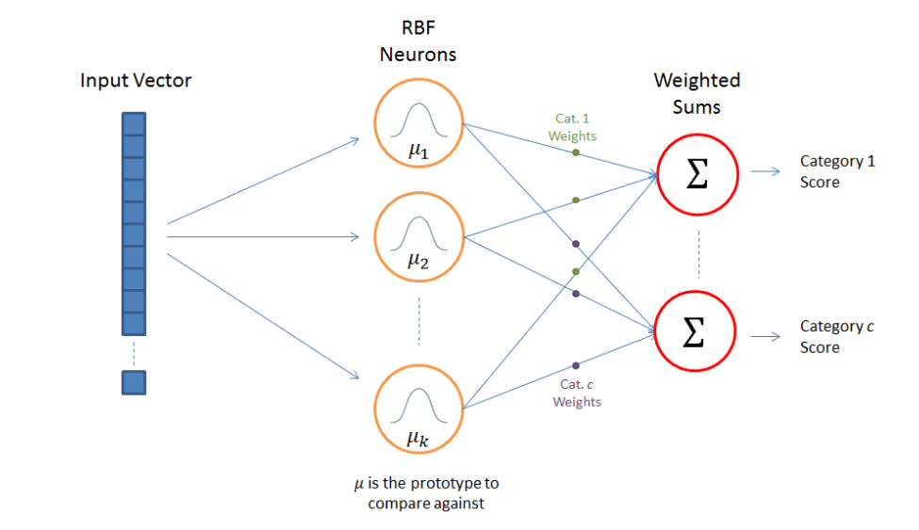
Radial Basis Function Neural Network
A radial basis function (RBF) is a function that assigns a real value to each input from its domain (it is a real-value function), and the value produced by the RBF is always an absolute value; i.e. it is a measure of distance and cannot be negative.
f(x) = f(||x||)
Euclidean distance, the straight-line distance between two points in Euclidean space, is typically used. Radial basis functions are used to approximate functions, much as neural networks act as function approximators.
RBF network represents a radial basis function network. The radial basis functions act as activation functions.
The approximant f(x) is differentiable with respect to the weights W, which are learned using iterative updater methods coming among neural networks.
Radial basis function neural networks are extensively applied in power restoration systems. In recent decades, power systems have become larger and more complex.
This increases the risk of blackout. This neural network is used in power restoration systems to restore power in the least amount of time.

Slide 6
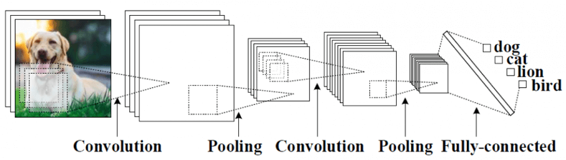
Convolutional Neural Network
Convolutional Neural Networks (CNN) is one of the variants of neural networks used heavily in the field of Computer Vision. It derives its name from the type of hidden layers it consists of. The hidden layers of a CNN typically consist of convolutional layers, pooling layers, fully connected layers, and normalization layers. Here it simply means that instead of using the normal activation functions defined above, convolution and pooling functions are used as activation functions.
For further assistance, code and slide https://fahadhussaincs.blogspot.com/
YouTube Channel : https://www.youtube.com/fahadhussaintutorial

Slide 7
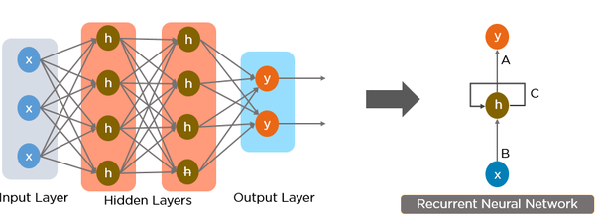
Recurrent Neural Network
Recurrent Neural Network(RNN) are a type of Neural Network where the output from previous step are fed as input to the current step. In traditional neural networks, all the inputs and outputs are independent of each other, but in cases like when it is required to predict the next word of a sentence, the previous words are required and hence there is a need to remember the previous words. Thus RNN came into existence, which solved this issue with the help of a Hidden Layer. The main and most important feature of RNN is Hidden state, which remembers some information about a sequence.
For further assistance, code and slide https://fahadhussaincs.blogspot.com/
YouTube Channel : https://www.youtube.com/fahadhussaintutorial

Slide 8
Thank You!
For further assistance, code and slide https://fahadhussaincs.blogspot.com/
YouTube Channel : https://www.youtube.com/fahadhussaintutorial

